Slide 1
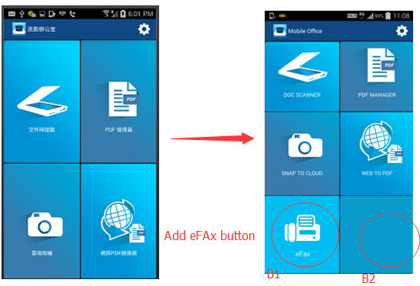
Mobile Office main page
- Add eFax button
B1 – eFax Button
- turn to eFax main screen
B2 – Blank button
- Do noting

Slide 2
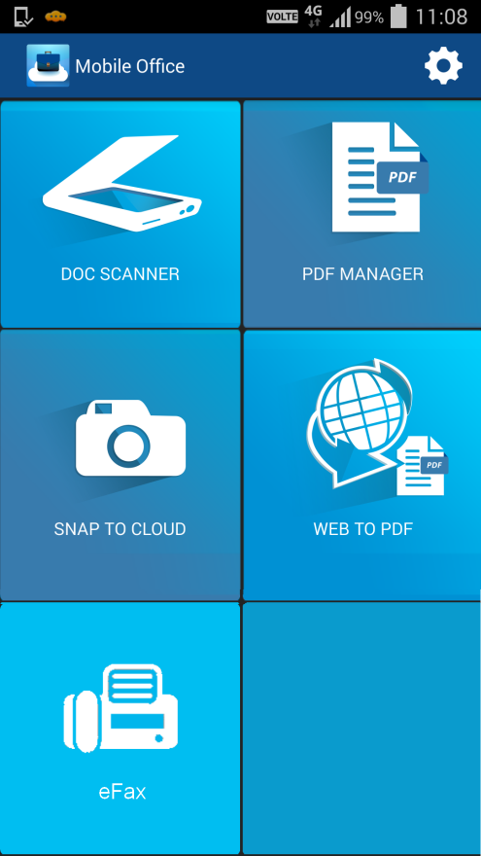
Main
If eFax event plan code is subscribed, eFax function will be visible to end user. Otherwise, it’s hidden.

Slide 3
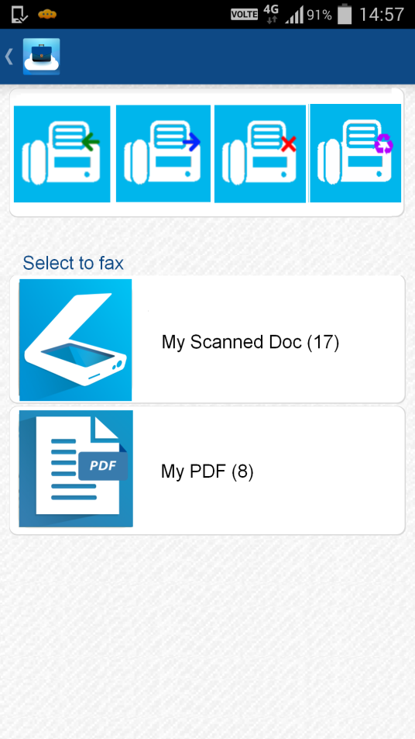
eFax – First page
On the top, show eFax number, e.g. My Fax (+852 2123-4567)
My Fax (+852 2123-4567)
2

Slide 4
eFax – First page (Con’t)
Then, show 4 IMAP folders from Surgemail server (received, sent, failed, recycle bin)
At the bottom, 2 choices (My Scanned Doc and My PDF) for users to select documents (pdf / jpg files) for outgoing fax.
My Fax (+852 2123-4567)
2

Slide 5
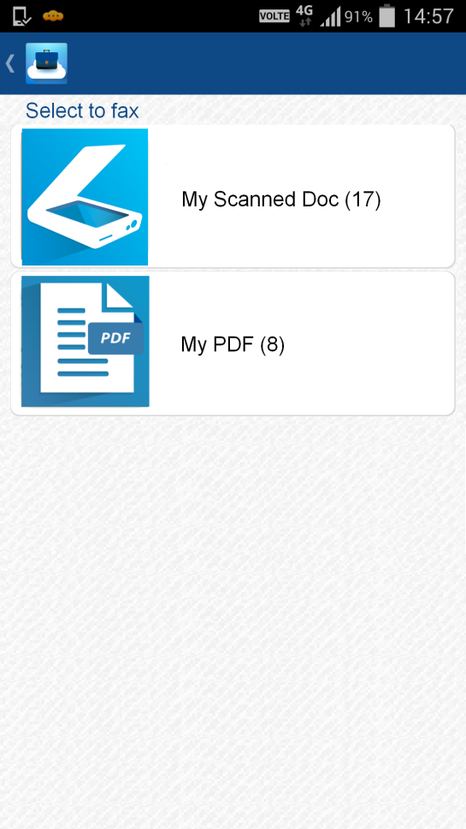
3 Modes
My Fax (+852 2123-4567)
My Fax (+852 2123-4567)
2
My Fax (+852 2123-4567)
(A) Dedicated mode (paid)
(B) Shared mode (paid)
(C) Shared mode (non-paid)

Slide 6




4 IMAP Folders
No of unread incoming fax
Icon | Folders | Visible / Invisible
 | Received Fax | (A) Dedicated mode (paid) : Visible (B) Shared mode (paid) : Visible (C) Shared mode (non-paid) : Invisible
 | Sent Fax | (A) Dedicated mode (paid) : Visible (B) Shared mode (paid) : Visible (C) Shared mode (non-paid) : Invisible* *Limitation : Can’t notify the result to multiple users in one fax account
 | Failed Fax | (A) Dedicated mode (paid) : Visible (B) Shared mode (paid) : Visible (C) Shared mode (non-paid) : Invisible
 | Recycle Bin | (A) Dedicated mode (paid) : Visible (B) Shared mode (paid) : Visible (C) Shared mode (non-paid) : Invisible
2

